Slide 1
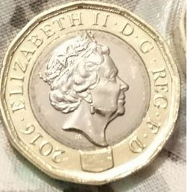
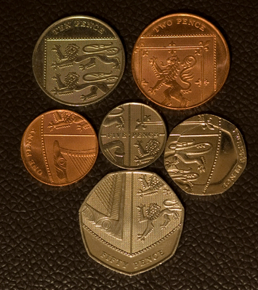
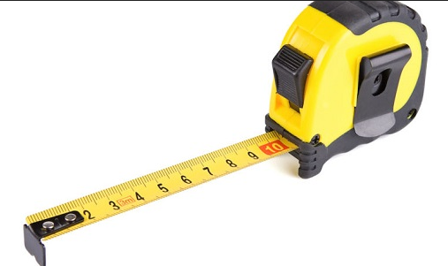
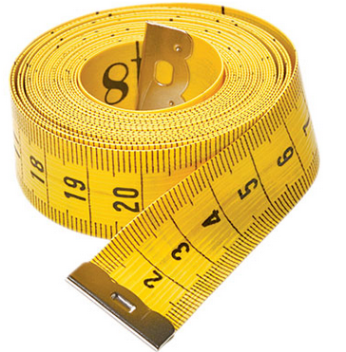
Money
Length
10 mm = 1cm
100 cm = 1 m
1000 m = 1 km
mm ÷ 10 ---> cm
cm x 10 ---> mm
cm ÷ 100 ---> m
m x 100 ---> cm
m ÷ 1000 ---> km
km x 1000 ---> m
100p = £1
pence ÷ 100 ---> pounds
pounds x 100 ---> pence

Slide 2
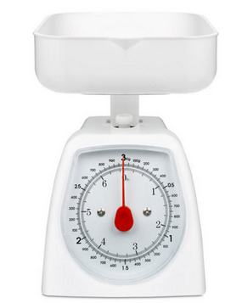
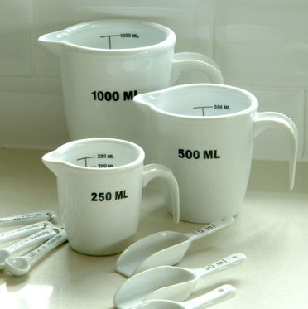
Capacity
1000 ml = 1 litre
millilitres ÷ 1000 ---> litres
litres x 1000 --->millilitres
Weight
1000 g = 1 kg
grams ÷ 1000 ---> kilograms
kilograms x 1000 ---> grams

