Slide 1
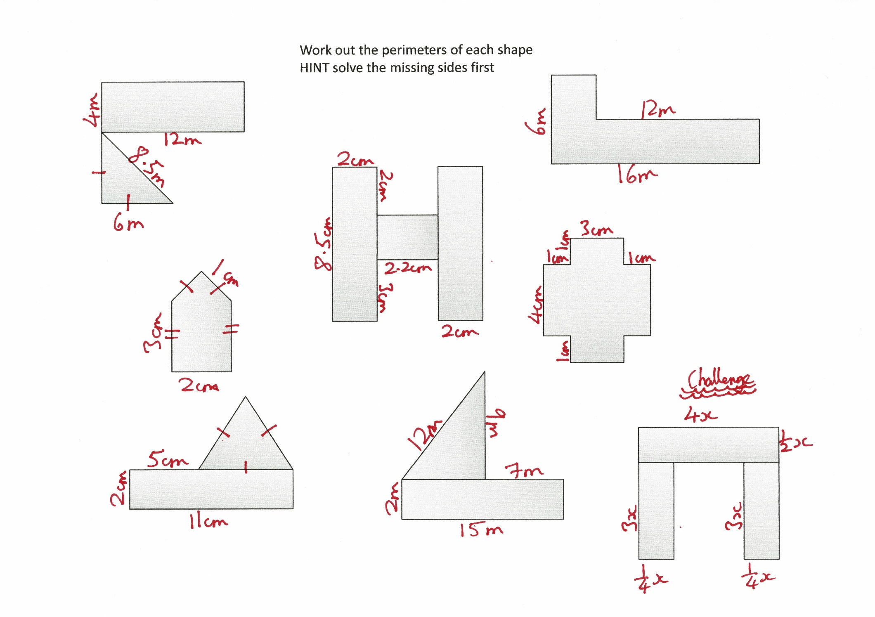

Slide 2
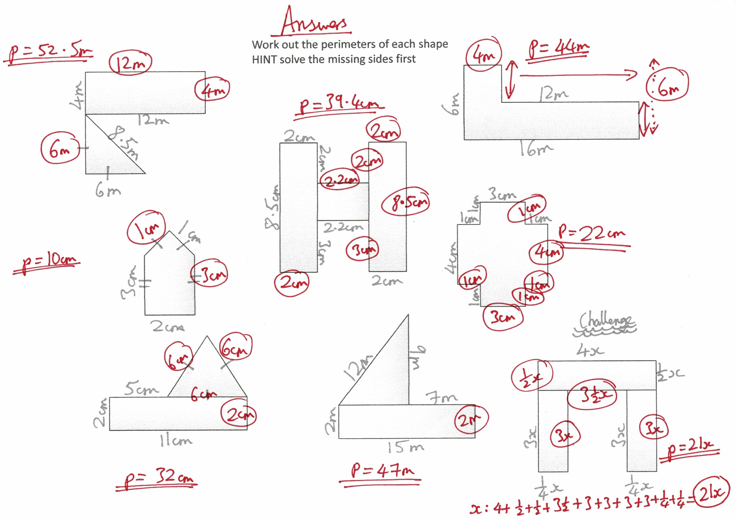

Slide 3
Work out the perimeters of each shape
HINT solve the missing sides first

